Slide 1
Sensors
NC 812/ESD 812

Slide 2
Sensors
Definition: a device for sensing a physical variable of a physical system or an environment
Classification of Sensors
Mechanical quantities: displacement, Strain, rotation velocity, acceleration, pressure, force/torque, twisting, weight, flow
Thermal quantities: temperature, heat.
Electromagnetic/optical quantities: voltage, current, frequency phase; visual/images, light; magnetism.
Chemical quantities: moisture, pH value

Slide 3
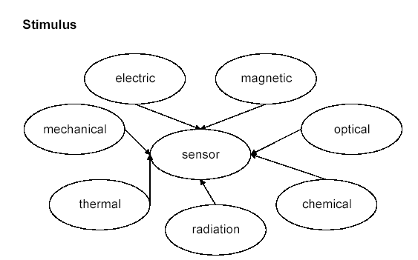
Stimulus

Slide 4
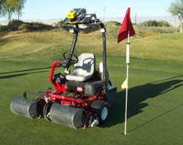

Why do we need sensors?

Slide 5
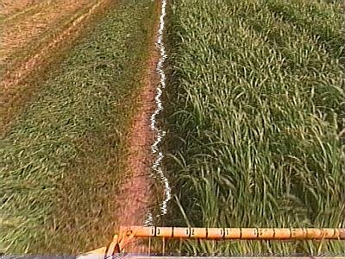
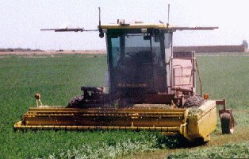
Sensing for Specific Tasks

Slide 6
Sensors
Main categories
Any energy radiated? Passive vs. active sensors
Sense of direction? Omidirectional?
Passive, omnidirectional
Examples: light, thermometer, microphones, hygrometer, …
Passive, narrow-beam
Example: Camera
Active sensors
Example: Radar

Slide 7
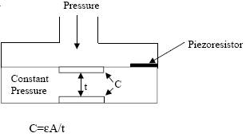
Examples
Light Sensor
photoconductor
light → ΔR
photodiode
light → ΔI
membrane pressure sensor
resistive (pressure → Δ R)
capacitive (pressure → ΔC)

Slide 8
Definitions
Measurement error: That is the difference between the measured value and the true value. error = measured value - true value
Deterministic errors: They are repeated at every measurement, e.g. reading offset or bias. Such errors can be corrected by calibration.
Random errors: They are caused by several parameters and change in time in an unpredictable fashion. They can be quantified by mean errors, standard deviation.
Precision: Measurements with small deviation
Accuracy: Measurements with small errors, i.e. small bias and high precision.

Slide 9
Sensor properties
output
factual
ideal
input
A sensor should represent a physical variable as fast and as accurately as possible.
A sensor is represented by its characteristics. Ideally, the sensor characteristic is a straight line

Slide 10
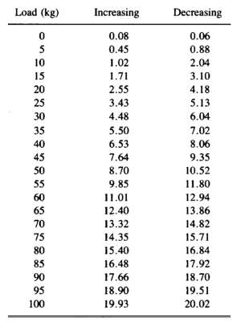
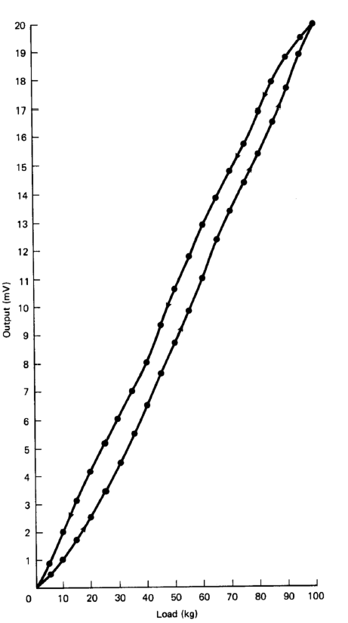

Slide 11
Sensor Characteristics
Full scale input (input span)
A range of stimuli that can be converted by one sensor.
Full scale output (output span)
Full scale output is the algebraic difference between the output signals measured with maximum input stimulus and with minimum input stimulus applied.

Slide 12
Specifications of Sensor
Accuracy: error between the result of a measurement and the true value being measured.
Resolution: the smallest increment of measure that a device can make.
Sensitivity: the ratio between the change in the output signal to a small change in input physical signal. Slope of the input-output fit line.
Repeatability/Precision: the ability of the sensor to output the same value for the same input over a number of trials

Slide 13
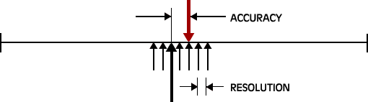
Accuracy vs. Resolution
True value
measurement

Slide 14
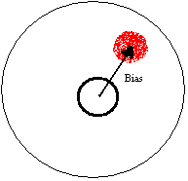
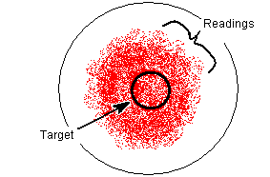
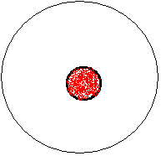
Accuracy vs. Precision
Precision without accuracy
Accuracy without precision
Precision and accuracy

Slide 15
Specifications of Sensor
Dynamic Range: the ratio of maximum recordable input amplitude to minimum input amplitude, i.e. D.R. = 20 log (Max. Input Ampl./Min. Input Ampl.) dB
Linearity: the deviation of the output from a best-fit straight line for a given range of the sensor
Transfer Function (Frequency Response): The relationship between physical input signal and electrical output signal, which may constitute a complete description of the sensor characteristics.
Bandwidth: the frequency range between the lower and upper cutoff frequencies, within which the sensor transfer function is constant gain or linear.
Noise: random fluctuation in the value of input that causes random fluctuation in the output value

Slide 16
Types of Sensors
Active
send signal into environment and measure interaction of signal with environment
e.g. radar, sonar
Passive
record signals already present in environment
e.g. temperature, pressure sensor.

Slide 17
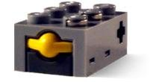
Touch sensors

Slide 18
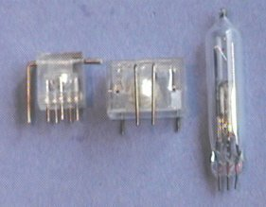
Tilt sensors

Slide 19
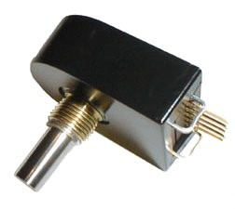
Encoders
Encoders measure rotational motion. They can be used to measure the rotation of a wheel.
Servo motors: Used in conjunction with an electric motor to measure the motor’s position and, in turn, control its position.

Slide 20
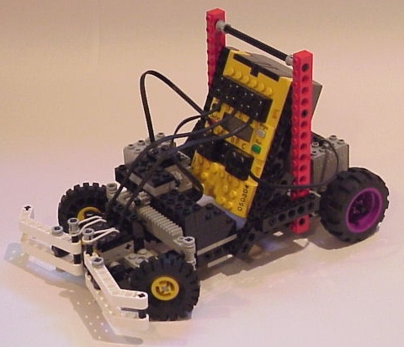
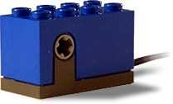
Sample problems
Sensor Analysis
How far does the wheel travel for 1 encoder count?
What happens if we change the wheel diameter?
How many counts are there per meter of travel?

Slide 21
Problem

Slide 22
Problem
Suppose I want 1.0 cm / count.
What should my wheel diameter be?
For my 10 cm wheel, how many encoder counts will there be for 1 meter of travel?

Slide 23
Problem
For my 10 cm wheel, how many encoder counts will there be for 1 meter of travel?

Slide 24
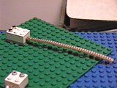
Flex sensor

Slide 25

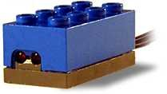
Light sensor

Slide 26
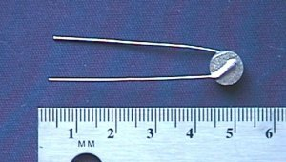

Temperature sensor

Slide 27

Potentiometer

Slide 28
Problem

Slide 29
Problem

Slide 30
Sensors Based on EM Spectrum
Used for ranging
Light sensitive
eyes, cameras, photocells etc.
Operating principle
CCD - charge coupled devices
Photoelectric effect
IR sensitive -
sense heat differences and construct images
night vision application

Slide 31
EM Spectrum
Radio and Microwave
RADAR: Radio Detection and Ranging
Microwave radar: insensitive to clouds
Coherent light
LASER: Light Amplification by Stimulated Emission of Radiation
LASER RADAR: LADAR - accurate ranging

Slide 32
Local Proximity Sensing in EM
Infrared LEDs
cheap, active sensing
usually low resolution - normally used for presence/absence of obstacles rather than ranging
operate over small range

Slide 33
Sensors Based on Sound
SONAR: Sound Navigation and Ranging
bounce sound off of something
measure time for reflection to be heard - gives a range measurement
measure change in frequency - gives the relative speed of the object (Doppler effect)
bats and dolphins use it with amazing results
robots use it with less than amazing results

Slide 34
Odor Sensors
Detection of chemical compounds and their density in an area
spectroscopy - mostly lab restricted
fiber-optic techniques - recently developed
chemical detection - sniffers and electronic noses via “wet chemistry on a chip”
Vast applications (e.g. mine detection)

Slide 35
Touch Sensors
mechanical contact leads to
closing/opening of a switch
change in resistance of some element
change in capacitance of some element
change in spring tension
...

Slide 36
Proprioceptive Sensors
Encoders, Potentiometers
measure angle of turn via change in resistance or by counting optical pulses
Gyroscopes
measure rate of change of angles
fiber-optic (newer, better), magnetic (older)
Compass
measure which way is north
GPS: measure location relative to globe

Slide 37
Problem: Sensor Choice
Which sensors to employ ?
E.g. mapping
ranging - laser, sonar, IR, stereo camera pair
Factors
accuracy, cost, information needed etc etc.

Slide 38
Problem: Sensor Placement
Where do you put them ?
On/off board
If onboard - where ?
Reasonable arrangements - heuristic
Optimal arrangements - mathematically rigorous

Slide 39
Sensor Calibration
Sensors can exhibit non-ideal effects
offset: nominal output ≠ nominal parameter value
nonlinearity: output not linear with parameter changes
cross parameter sensitivity: secondary output variation with, e.g., temperature
Calibration
adjusting output to match parameter
analog signal conditioning
look-up table
digital calibration
Compensation
remove secondary sensitivities
must have sensitivities characterized
can remove with polynomial evaluation
linear
T1
non-linear
T2
offset
T3

Slide 40
Smart Sensors
A traditional integrated sensor can be divided into three parts:
The sensing element (e.g., resistors, capacitor, transistor, piezo-electric materials, photodiode, etc.),
Signal conditioning and processing (e.g., amplifications, linearization, compensation, and filtering), and
A sensor interface (e.g., the wires, plugs and sockets to communicate with other electronic components)
The essential difference between a smart sensor and a standard integrated sensor is its intelligence capabilities, i.e., the on-board microprocessor.

Slide 41
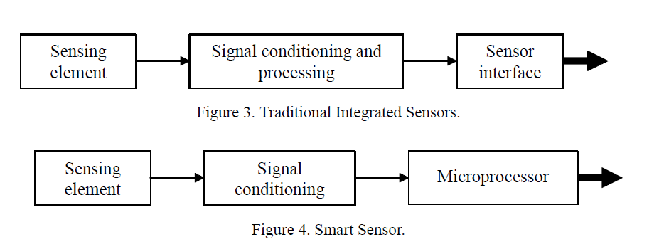
Smart Sensors

Slide 42
Smart Sensors
The microprocessor is typically used for digital processing, analog to digital or frequency to code conversions, calculations, and interfacing functions, which can facilitate self-diagnostics, self-identification, or self-adaptation (decision making) functions. It can also decide when to dump/store data, and control when and for how long it will be fully awake so as to minimize power consumption.
The size of smart sensors has been decreasing with time. The use of MEMS has made possible the dream of having ubiquitous sensing and in particular small “smart” sensing.

Slide 43
Smart Sensors
All smart sensors to date are wireless, with data transmission based on radio frequency (RF) communication. There exist several protocols for transmitting data.
Bluetooth: a short-range radio technology aimed at simplifying communication among devices
Zigbee: Low power, higher range compared to BT, reliably communication
WiFi (802.11a/g): Higher power consumption, better range, APs available easily.
Most of these sensors envision using low radiated power to avoid the heavy costs associated with certifying the sensor with the FCC. Therefore, a smart sensor as define herein has four important features: (i) on-board CentralProcessing- Unit (CPU), (ii) small size, (iii) wireless, and (iv) the promise of being low-cost.

Slide 44
Sensor Data Cleaning
Numerous issues arise in the context of collection of sensor data. Sensor data is inherently noisy and uncertain, and may either have missed readings or redundant readings depending upon the application domain.
Reliability can be improved by windowing approach.

Slide 45
Weighted Moving Average
Weighted moving average algorithm: A well known approach to remove noise in random samples and compute the monitoring values is to use the moving average.
Moving average in sensor networks has two dimensions. Sensor data are averaged temporally within one sensor, and also spatially among neighbouring sensors.
For example, at any time t, the algorithm first averages a sequence of samples at each sensor i.
We then average values of neighbouring sensors.

